Slide 1

Big Mountain Resort
Rohith Reddy
https://www.linkedin.com/in/rohithreddy-s/

Slide 2
Problem Identification
Big Mountain Resort is a ski resort located in Montana, offering views of Glacier National Park and Flathead National Forest, with access to 105 trails.
The resort recently added a new chairlift, increasing operating costs by $1.54M this season.
Current ticket prices may not fully cover this increased cost, so the business needs guidance to determine an optimal ticket price.

Slide 3
Recommendation & key Findings
Ticket Pricing is influenced by resort infrastructure and operational efficiency, not location or state size.
Normalized and ratio-based metrics provide more reliable insights than raw totals.
Lift Capacity, terrain size, Vertical drop, and snowmaking are consistent drivers of pricing differences.
Pricing relationships are nonlinear, required careful analysis.
Operational changes should be evaluated per ticket, not only as total costs.

Slide 4
Modeling Results & Analysis
Mean Predictor (Dummy Regressor) → Sets reference for improvement.
Linear Regression → Interpretable, captures basic relationship
Random Forest Regression → Captures nonlinear interactions, more accurate

Slide 5
Selected Model
Algorithms tested: Baseline (Mean), Linear Regression (Pipeline + Grid Search CV), Random Forest (Pipeline + Grid Search CV)
Random Forest (Grid Search CV - tuned) because of its Lower CV MAE and test MAE vs linear; more stable across folds; easier to capture non-linear effects.
Metric | Baseline (Mean) | Linear (Pipeline) | Random Forest (tuned)
MAE (Train) | 17.92 | 9.21 | N/A
MAE (Test) | 19.14 | 10.49 | 9.54
R² (Train) | N/A | 0.818 (Train) | N/A
R² (Test) | N/A | 0.721 (Test) | N/A

Slide 6
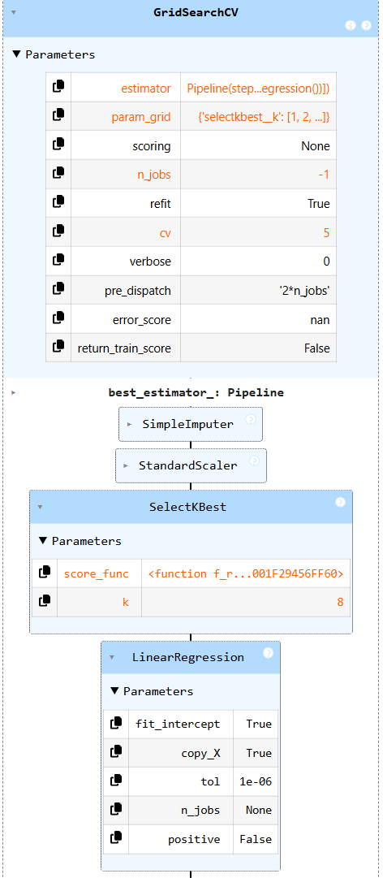
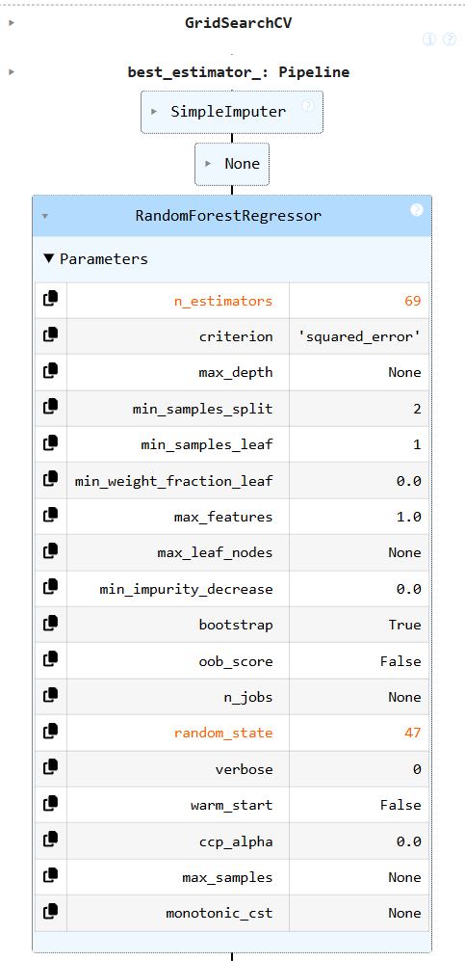
PIPELINES

Slide 7
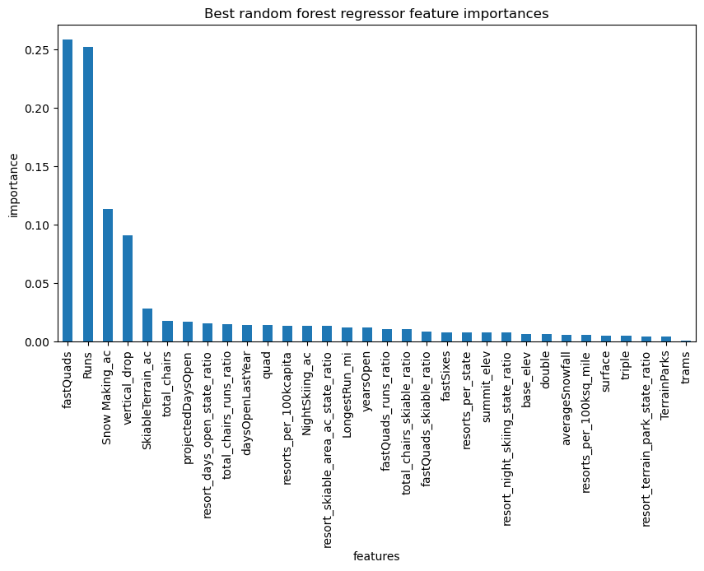

Slide 8
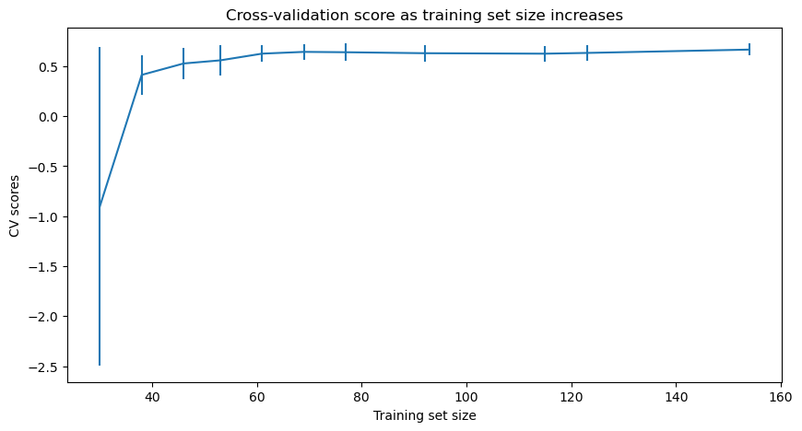

Slide 9
Summary & Conclusion
Big Mountain’s infrastructure investment improved visitor distribution and operational efficiency, strengthening the resort’s value proposition.
Pricing analysis shows that resort efficiency and offerings, rather than location or state size, drive ticket price support.
Operational metrics such as lift capacity, terrain utilization, and snowmaking are the strongest indicators of price positioning.
Big Mountain’s current adult weekend price of $81 is conservative, with modeling supporting approximately $95.87 (±$10.39).
The new chair lift adds just $0.88 per ticket, providing pricing flexibility without revenue risk.
Conclusion: Big Mountain has clear, data-supported room to re-align pricing with its operational value while remaining competitive.

Slide 10


